Slide 1
NCI update – analyzing CyTOF data
9 20 2024
Ty Bottorff – Bioinformatics postdoc
Linsley lab

Slide 2
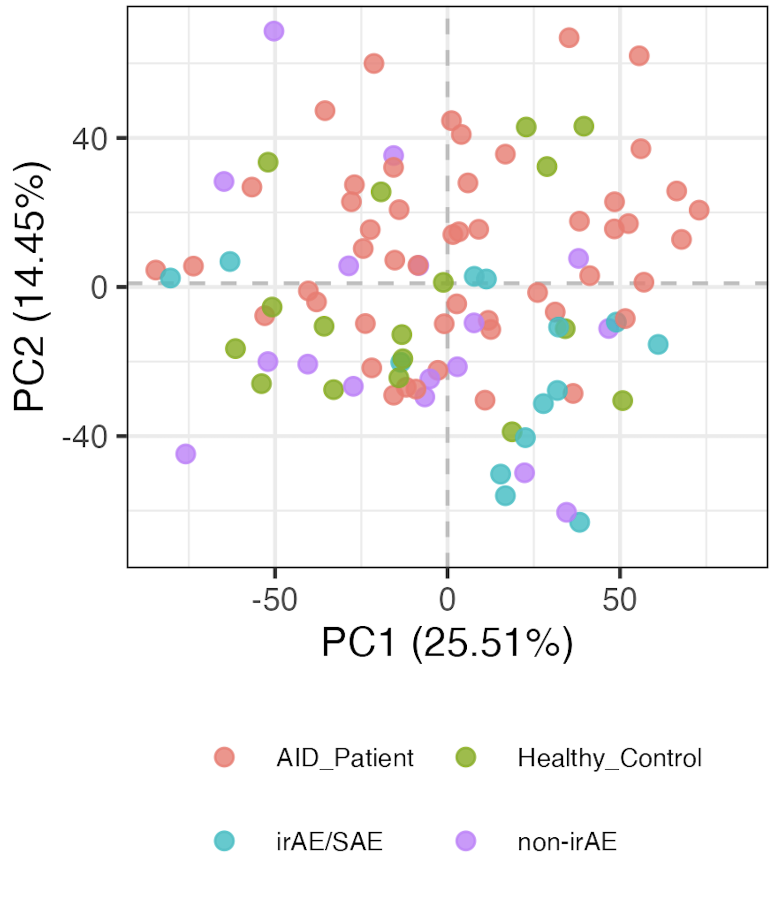
Baseline immunotypes are somewhat distinct by group
Notes:
Including all PD1/PDL1 sorts here but that’s fine I believe (baseline, no ICI yet)
Significant hits
# (severe) irAE vs. no irAE: none
# AID vs. HC, none
# AID vs. cancer:
# naive of CD8 Tcells, Treg of CD4 Tcells, Tcells of nonGrans, Tfh of NN Tconv Tcells, NKcells of nonGrans, CXCR3pos of NN CD8 Tcells, CD11cpos of Bcells, naive of Treg Tcells, MAIT of NN CD8 Tcells, unswMem of Bcells, CRTH2pos of NN CD8 Tcells
# AID vs. non-irAE: Treg of CD4 Tcells, naive of CD8 Tcells, CRTH2pos of NN CD8 Tcells, CCR4pos of NN Tconv Tcells, ICOSpos of Tfh Tconv Tcells
# AID vs. irAE: CD11cpos of Bcells, NKcells of nonGrans, Tcells of nonGrans, Tfh of NN Tconv Tcells, naive of CD8 Tcells, unswMem of Bcells, Bcells of nonGrans, CXCR3pos of NN CD8 Tcells
# HC vs. cancer: CD38hiCD127neg of NN CD8 Tcells, Treg of CD4 Tcells
# HC vs. non-irAE: CRTH2pos of NN Tconv Tcells, Treg of CD4 Tcells, CD38hiCD127neg of NN CD8 Tcells, CRTH2pos of NN CD8 Tcells, SCM of Tconv Tcells
# HC vs. irAE: none

Slide 3
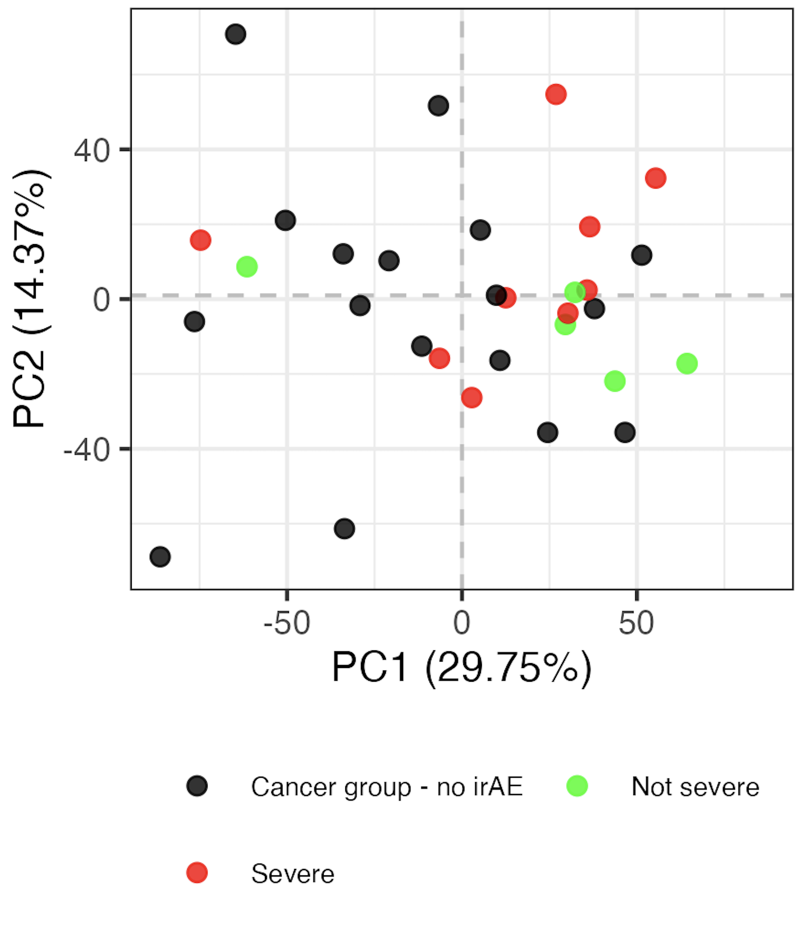
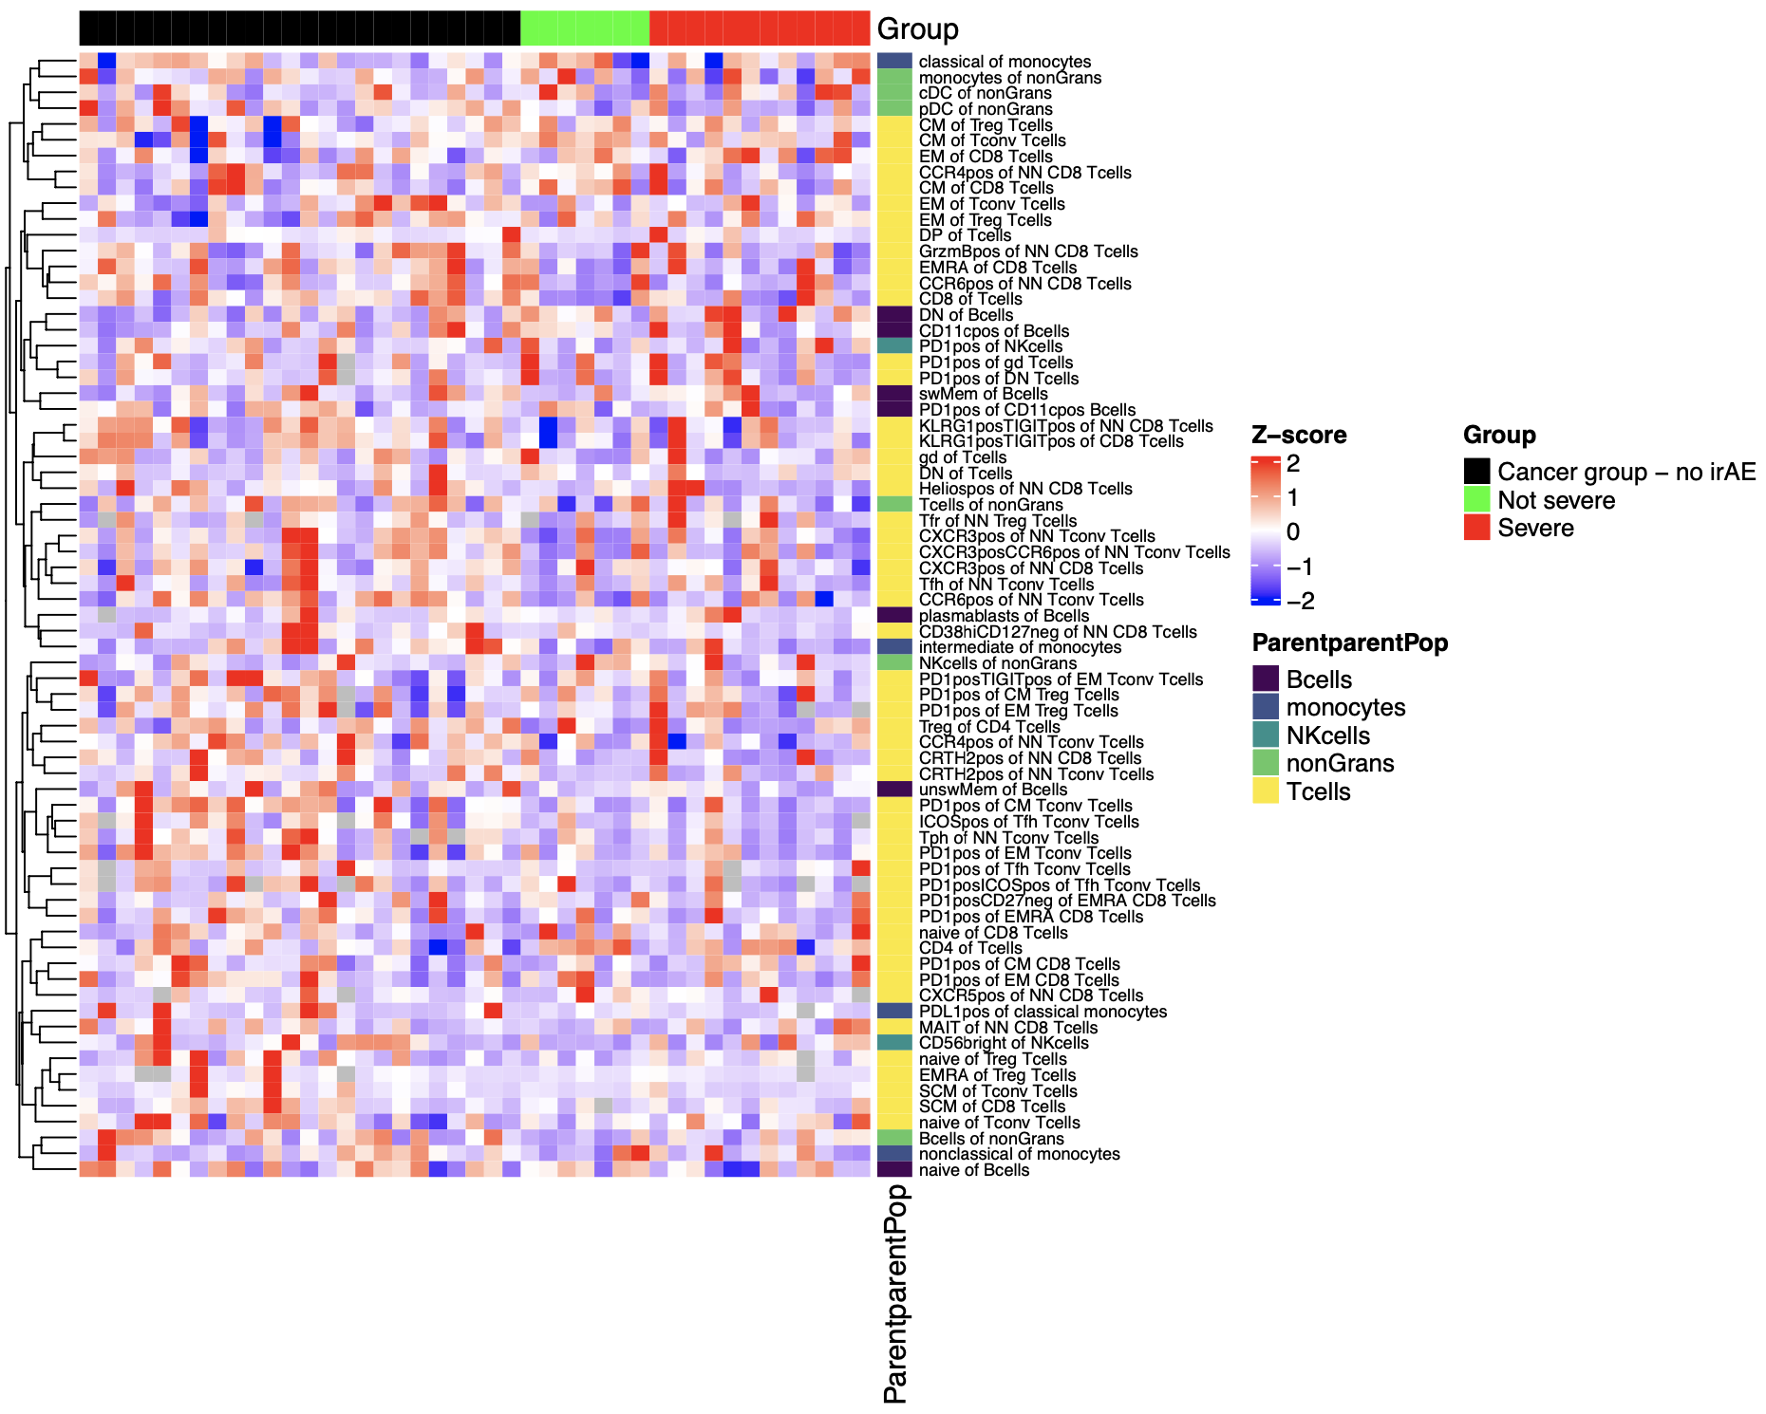
Different irAE groups do not appear to have distinct immunotypes at baseline
~not exactly same as Holly’s severity split but still same conclusion
Notes:
My severity split:
Severe if str_detect(“Encephalitis|Pleural effusion|pneumonitis|hepatitis|esophagitis|thyroid|Thyroid”)
Including all PD1/PDL1 sorts here but that’s fine I believe (baseline, no ICI yet)

Slide 4
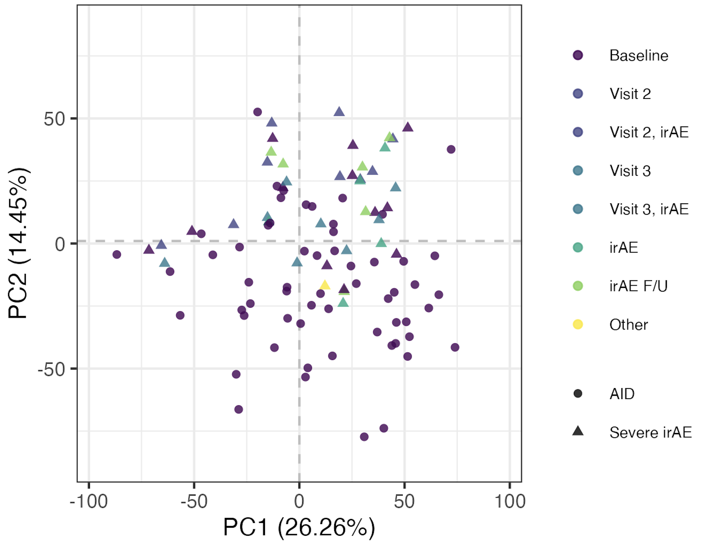
1st pass: changes in immunotypes during ICI/irAE development do not appear to bring baseline immunotypes closer to variable AID ones
Notes:
over ICI/irAE development do immunotypes of irAE patients resemble those of AID patients more
Aim 3: Determine whether ICI alters the T cell landscape similar to that seen in natural autoimmunity.

Slide 5
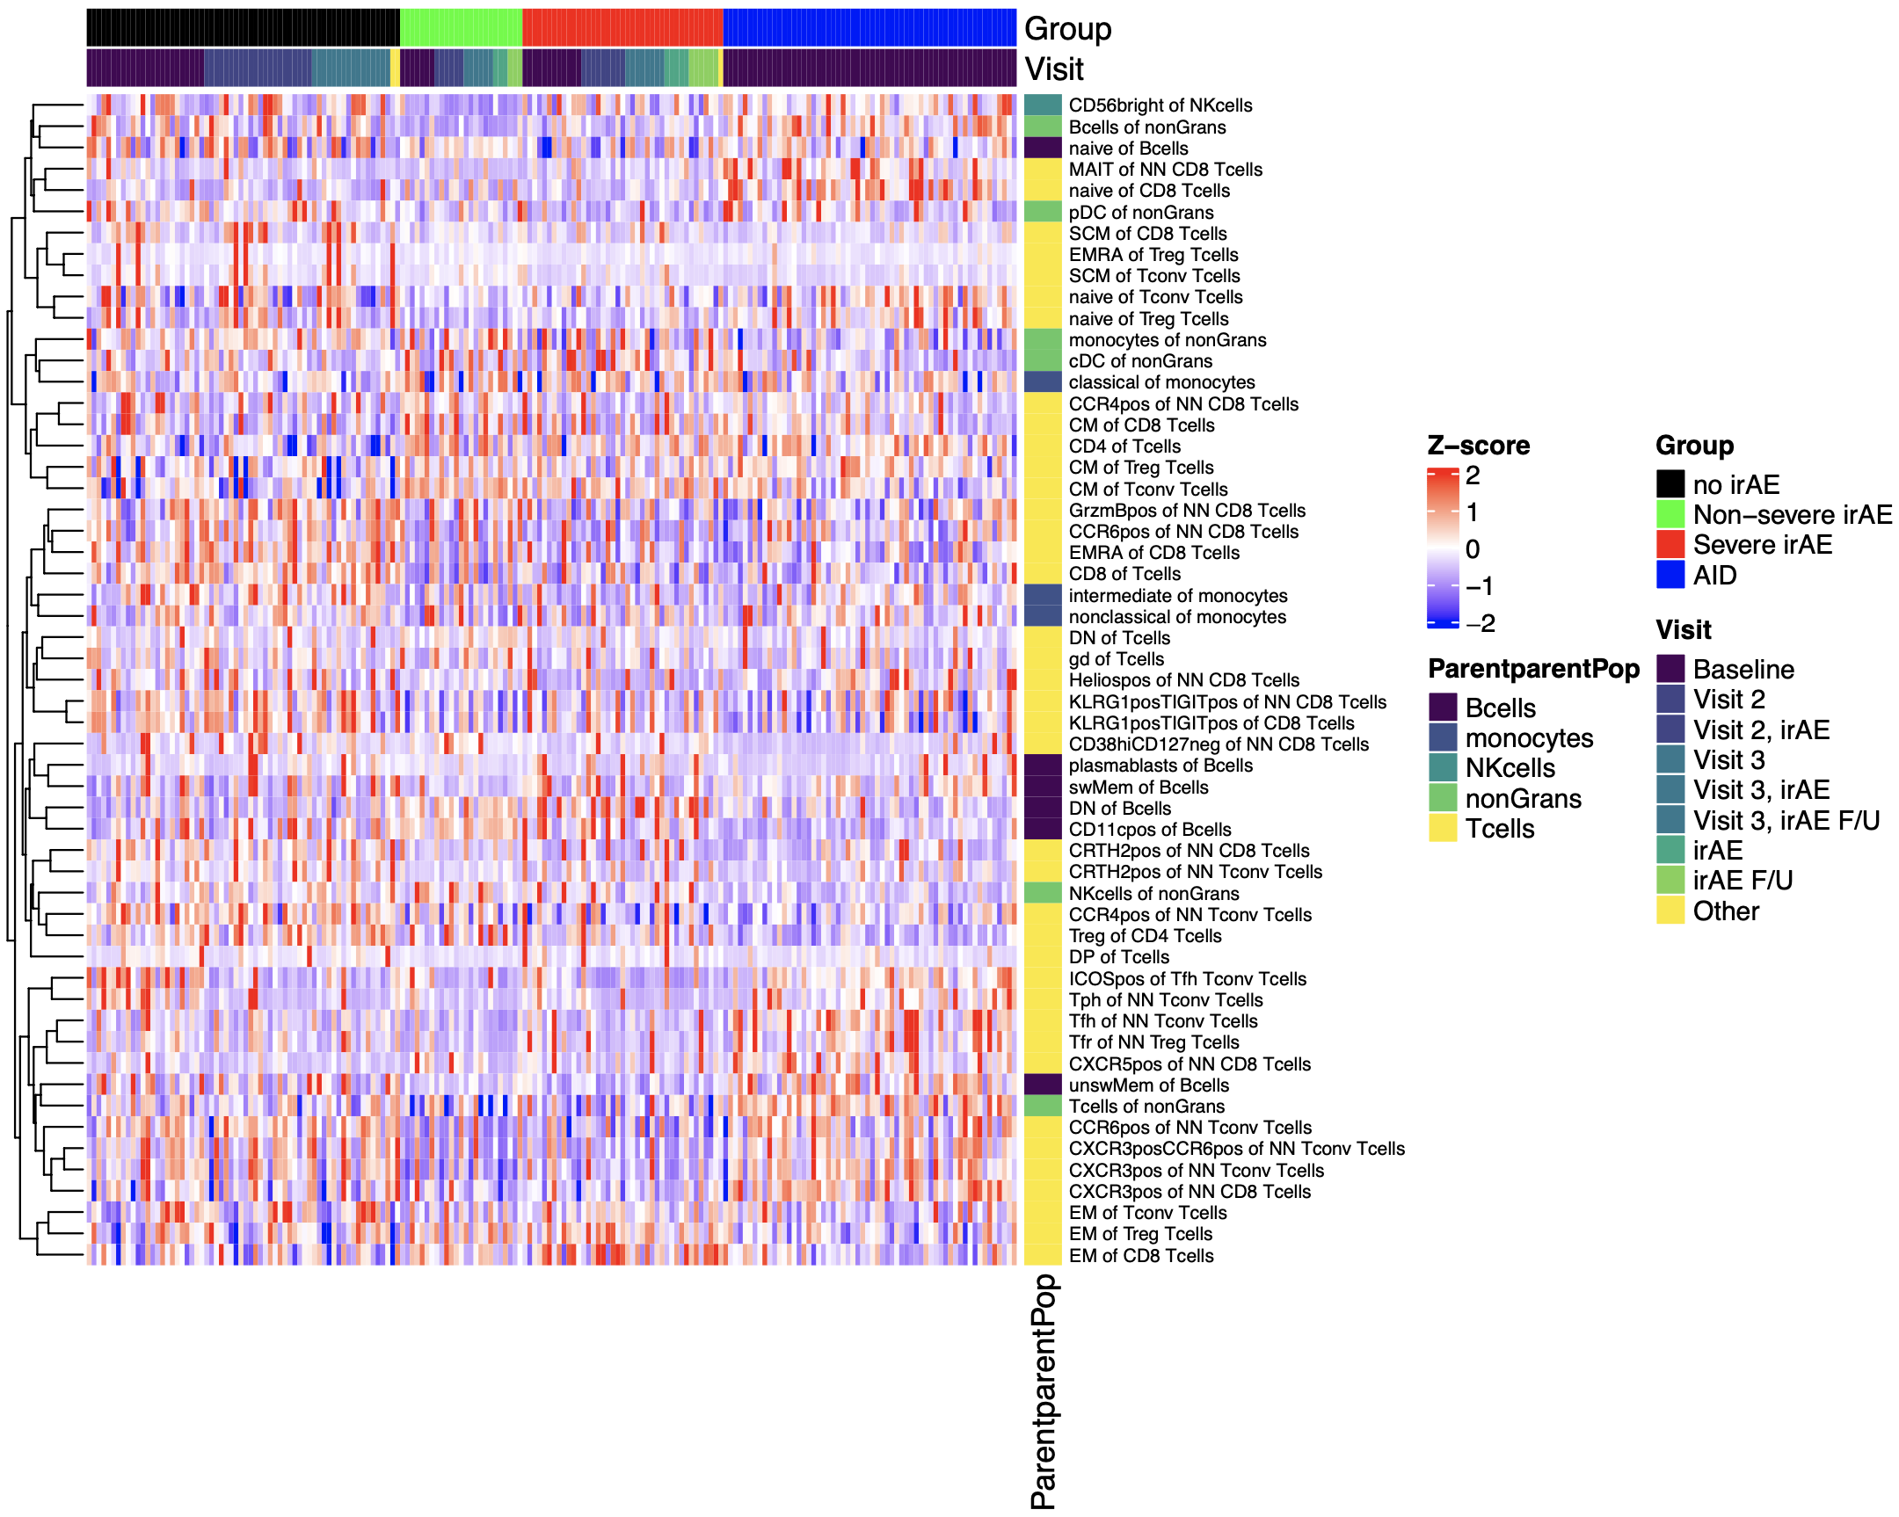
More analyses required to untangle possible ICI/irAE effects when considering all timepoints
Notes:
Removed PD sorts as they were clear ICI effects across all irAE groups

Slide 6
Conclusions
baseline immunotypes are somewhat distinct by AID, HC, or cancer group; irAE cancer subgroups’ immunotypes are similar
at first pass, changes in immunotypes during ICI/irAE development do not appear to bring baseline immunotypes closer to variable AID ones

Slide 7
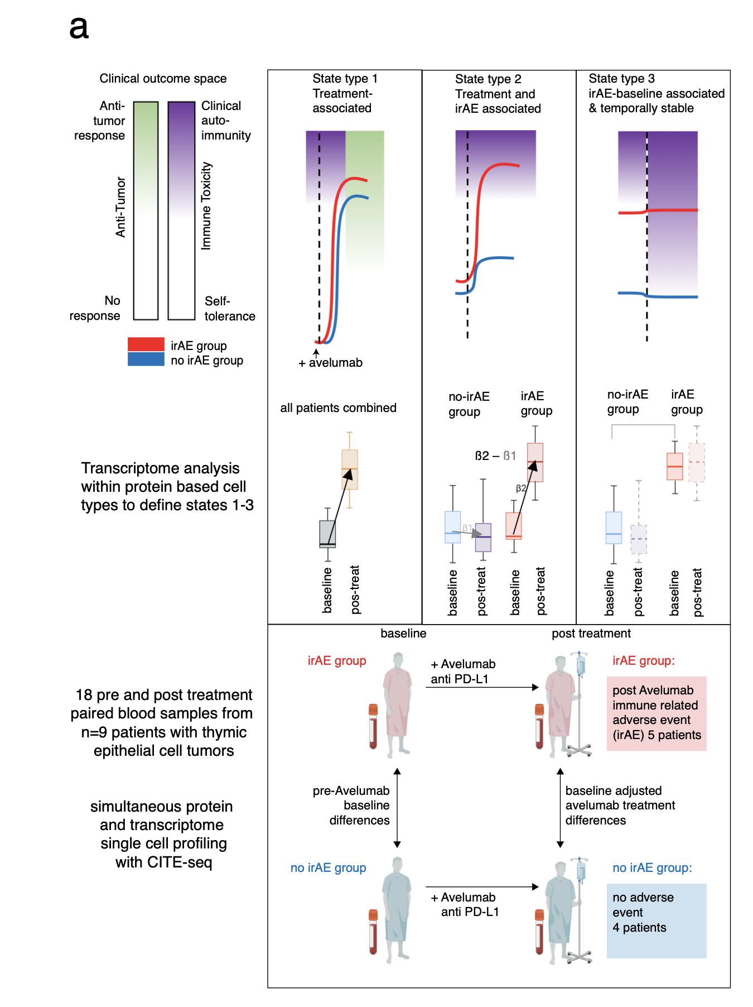
Next steps
Fixed/mixed effects modeling: uncouple baseline states associated with irAE development from ICI and ICI+irAE effects
Zhao et al. (bioRxiv) 2022
Notes:
Mixed meaning fixed + random (like donor) effects
2nd point (modeling):: find if there are any subsets that differentially change over ICI in different irAE groups, plus baseline predictors perhaps of irAE
subtract ICI & irAE-ICI effects from baseline

Slide 8

Acknowledgements
Holly Akilesh
Hannah DeBerg

Slide 9
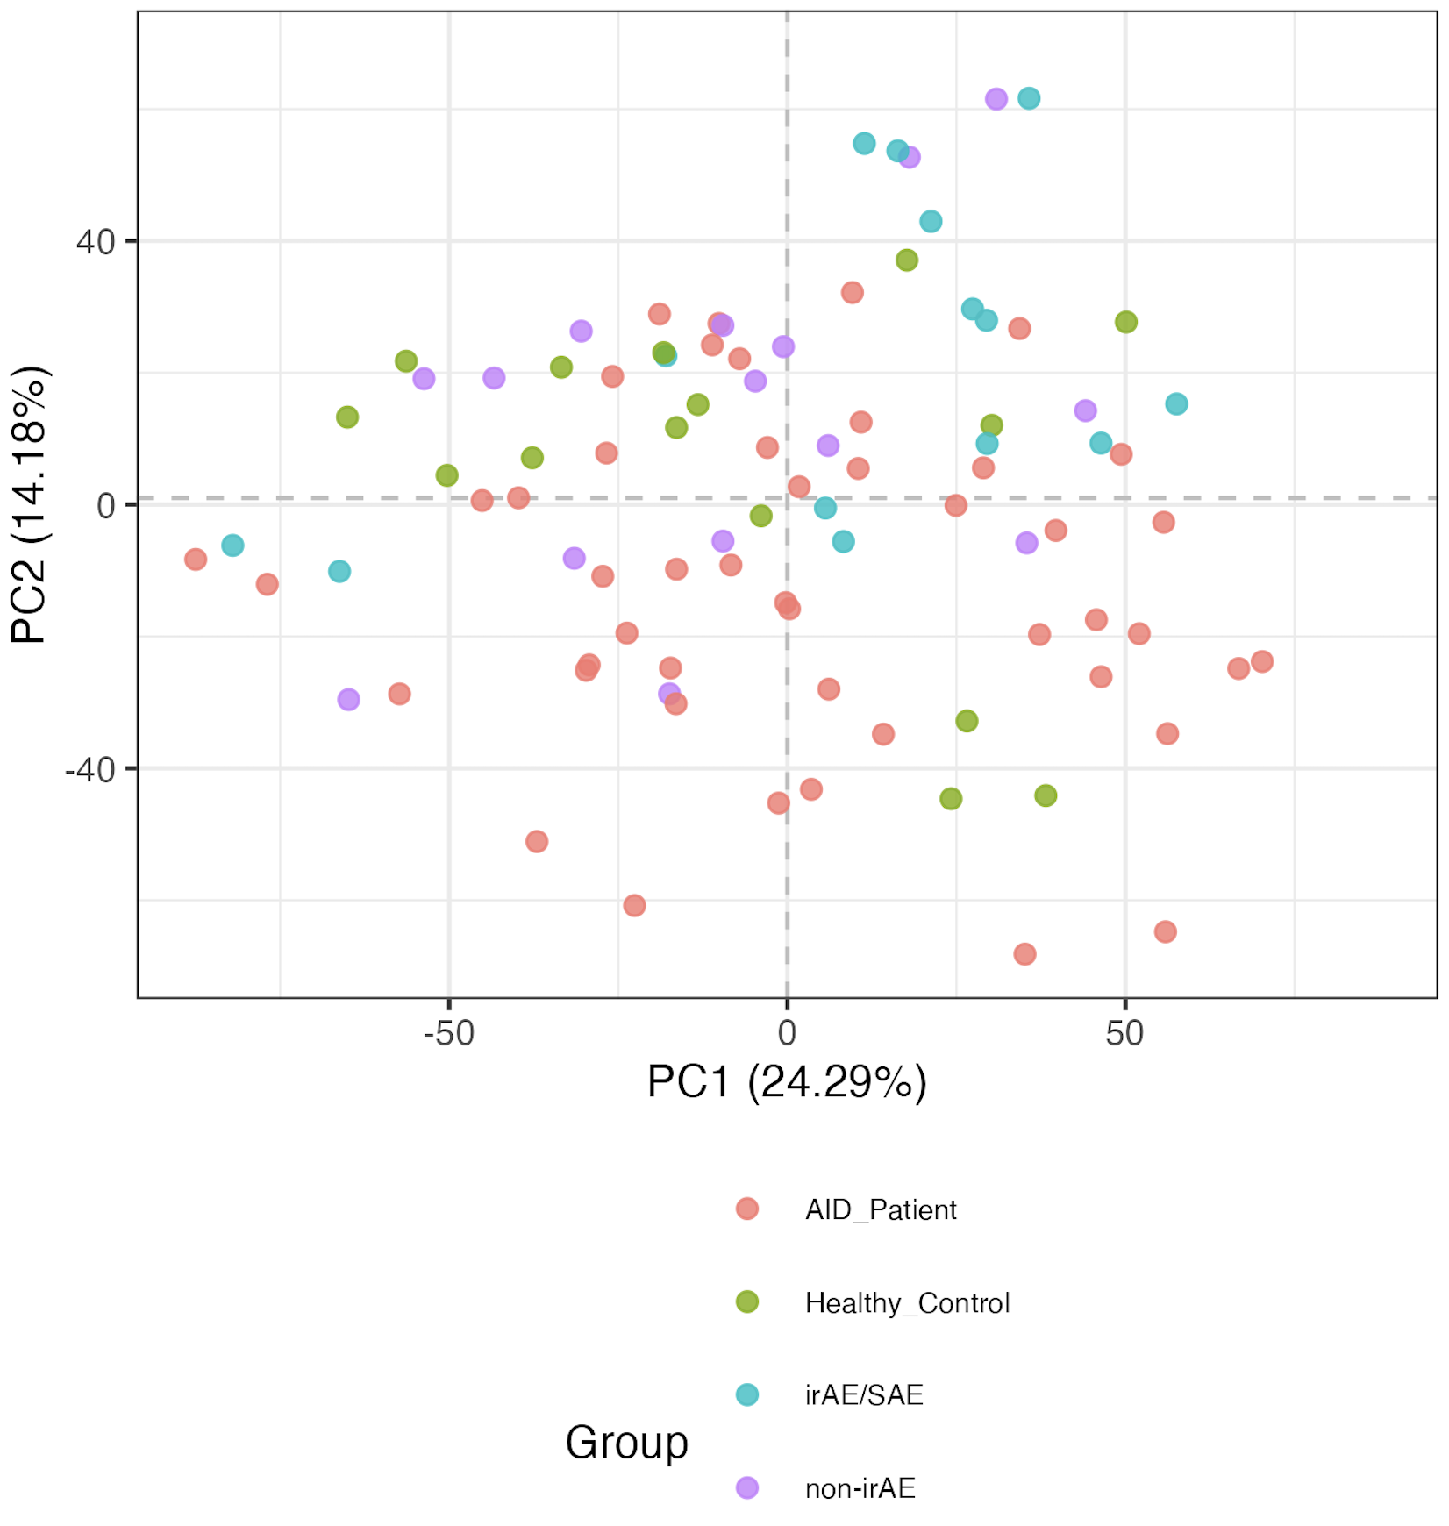
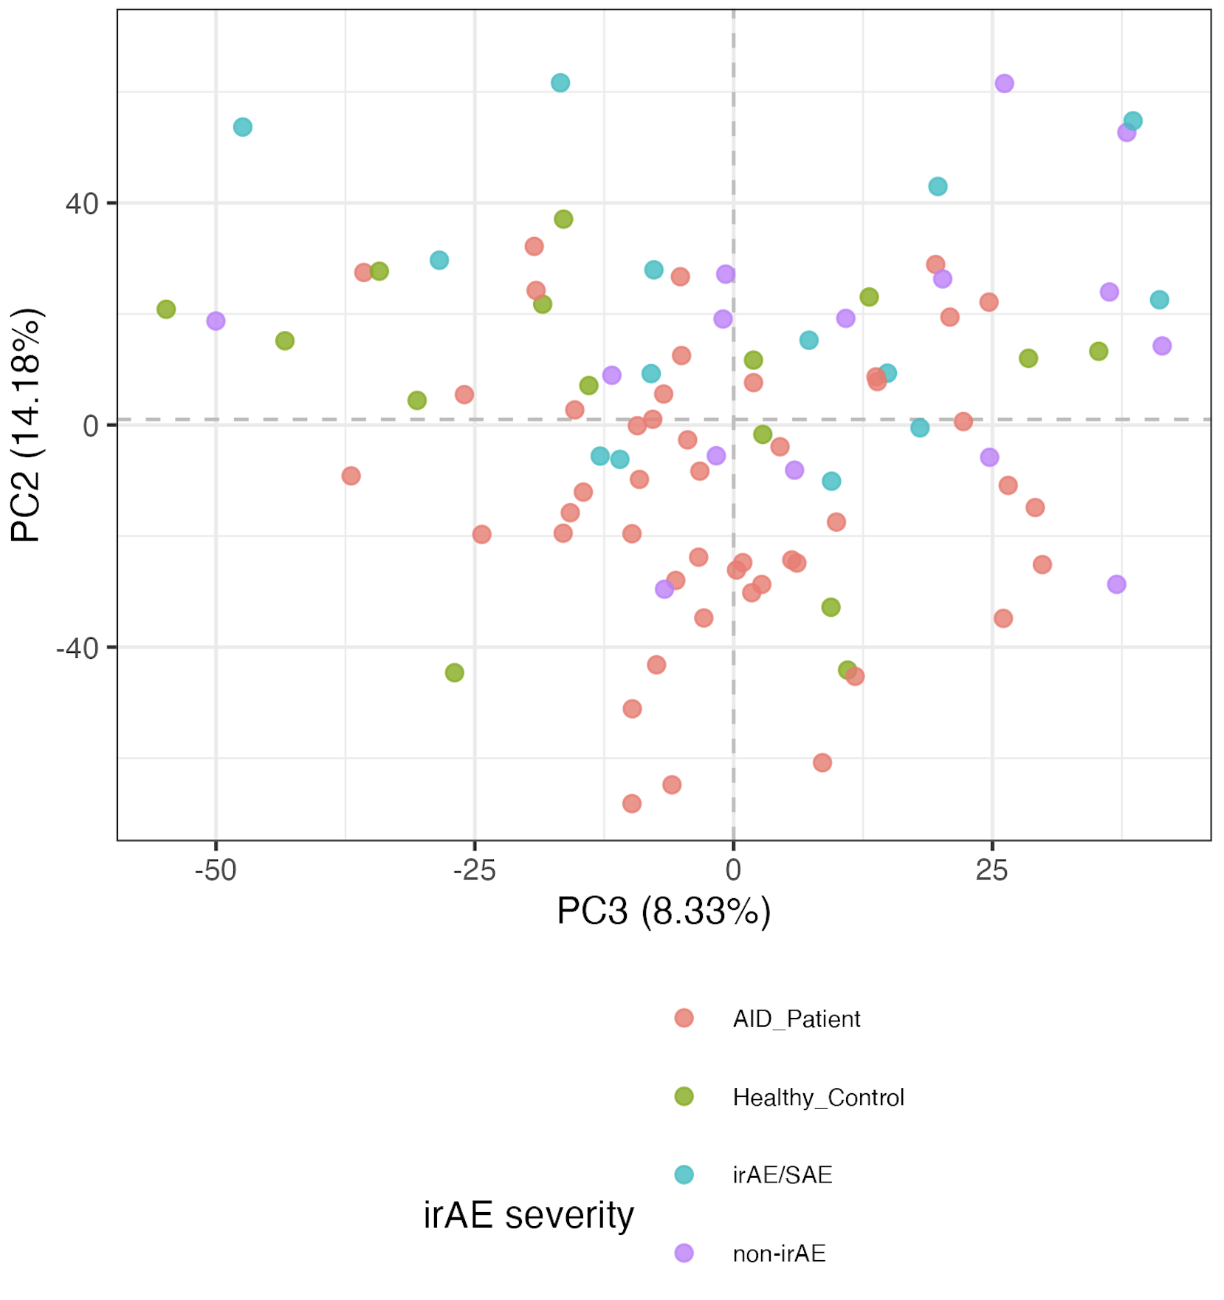
All baseline data: immunotypes, PCs 1-3
Notes:
Including all PD1/PDL1 sorts here but that’s fine I believe (baseline, no ICI yet)
Significant hits
# (severe) irAE vs. no irAE: none
# AID vs. HC, none
# AID vs. cancer:
# naive of CD8 Tcells, Treg of CD4 Tcells, Tcells of nonGrans, Tfh of NN Tconv Tcells, NKcells of nonGrans, CXCR3pos of NN CD8 Tcells, CD11cpos of Bcells, naive of Treg Tcells, MAIT of NN CD8 Tcells, unswMem of Bcells, CRTH2pos of NN CD8 Tcells
# AID vs. non-irAE: Treg of CD4 Tcells, naive of CD8 Tcells, CRTH2pos of NN CD8 Tcells, CCR4pos of NN Tconv Tcells, ICOSpos of Tfh Tconv Tcells
# AID vs. irAE: CD11cpos of Bcells, NKcells of nonGrans, Tcells of nonGrans, Tfh of NN Tconv Tcells, naive of CD8 Tcells, unswMem of Bcells, Bcells of nonGrans, CXCR3pos of NN CD8 Tcells
# HC vs. cancer: CD38hiCD127neg of NN CD8 Tcells, Treg of CD4 Tcells
# HC vs. non-irAE: CRTH2pos of NN Tconv Tcells, Treg of CD4 Tcells, CD38hiCD127neg of NN CD8 Tcells, CRTH2pos of NN CD8 Tcells, SCM of Tconv Tcells
# HC vs. irAE: none

Slide 10
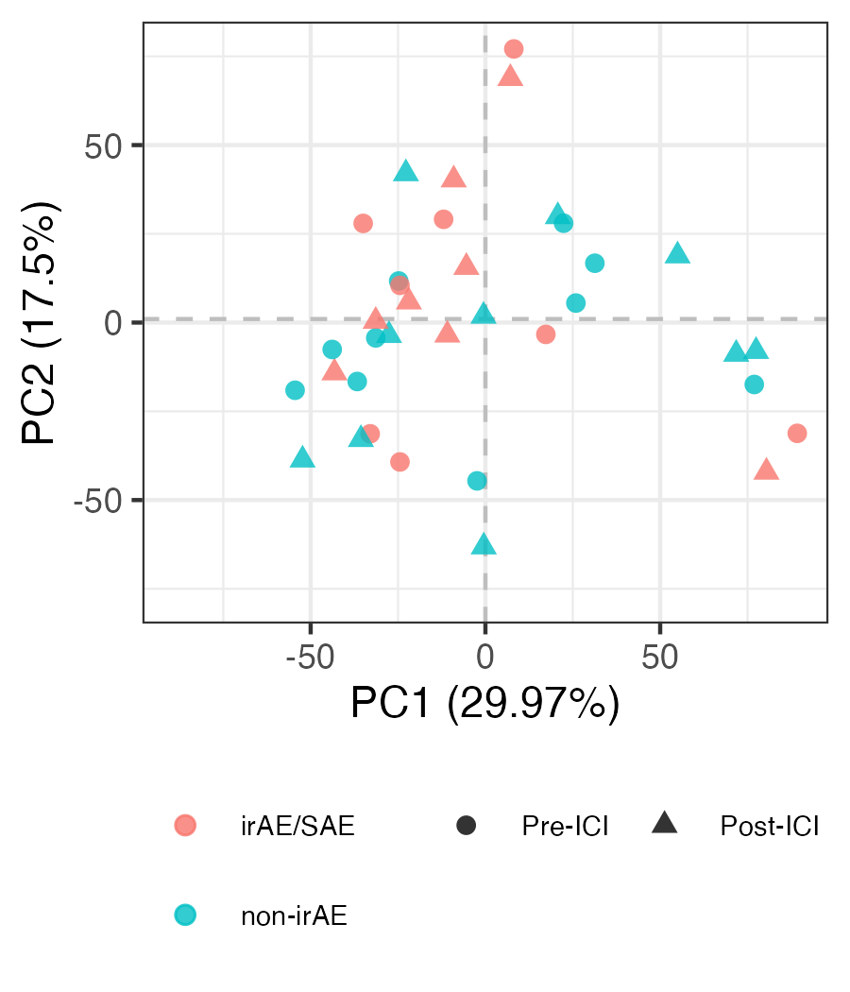
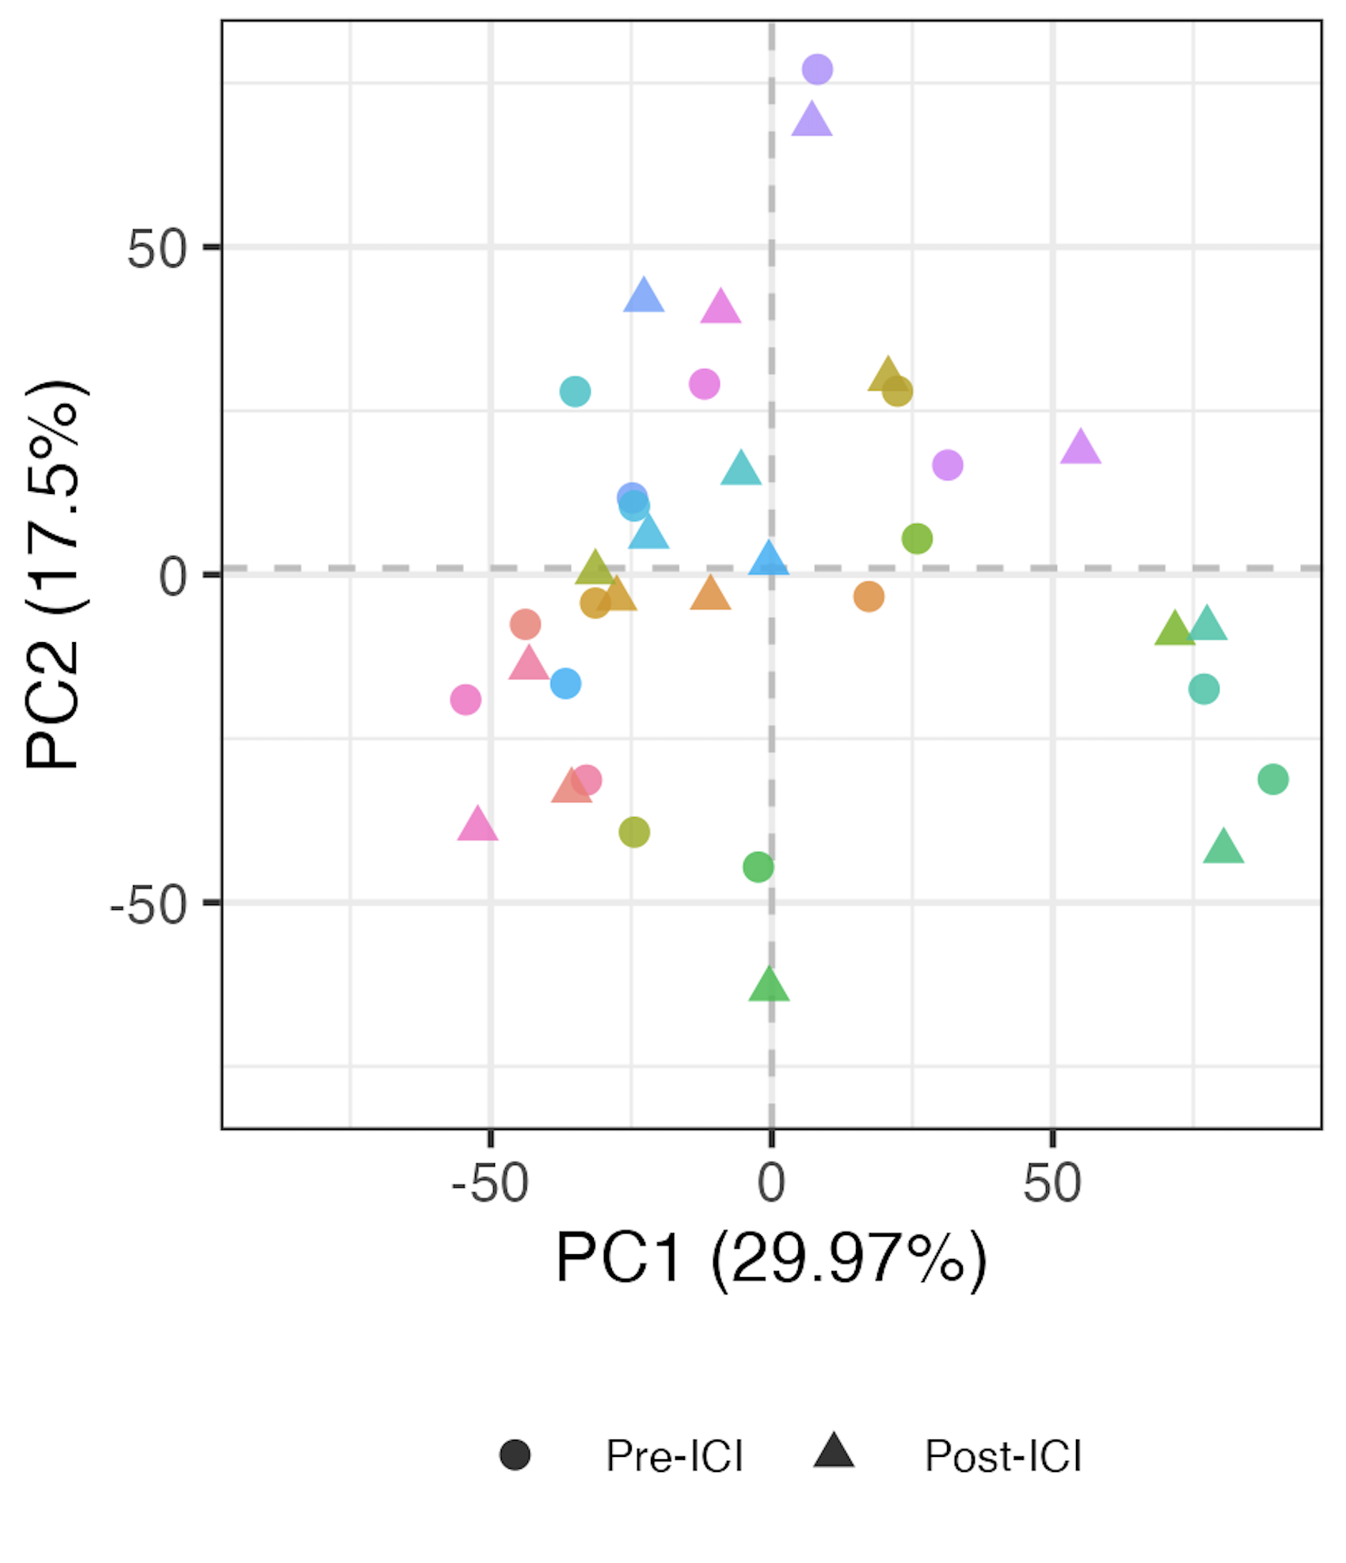
Some immune features change over ICI (visit 3/2 vs. visit 1)
Color is patient ID

Slide 11
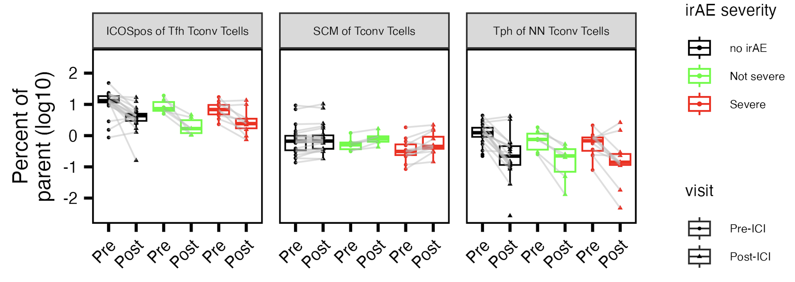
Immune features that change over ICI (visit 3/2 vs. visit 1)
*
*
*
*
Wilcoxon rank sum test. *: padj < 0.05. Not severe & severe irAE groups grouped
Notes:
Subsets with padj < 0.05 (combining irAEs by severity into 1 group for test)
Excluding PD1/PDL1 subsets

